Slide 1
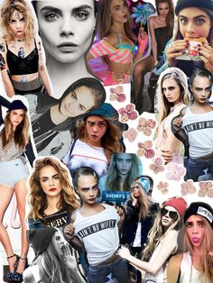
Hidden Picture Celebrities

Slide 2
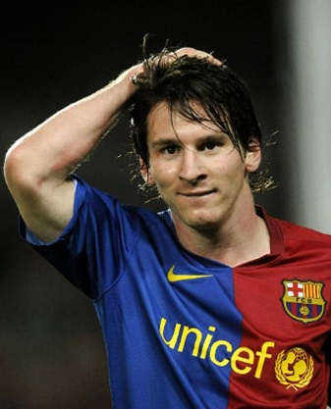
Messy
Remove

Slide 3
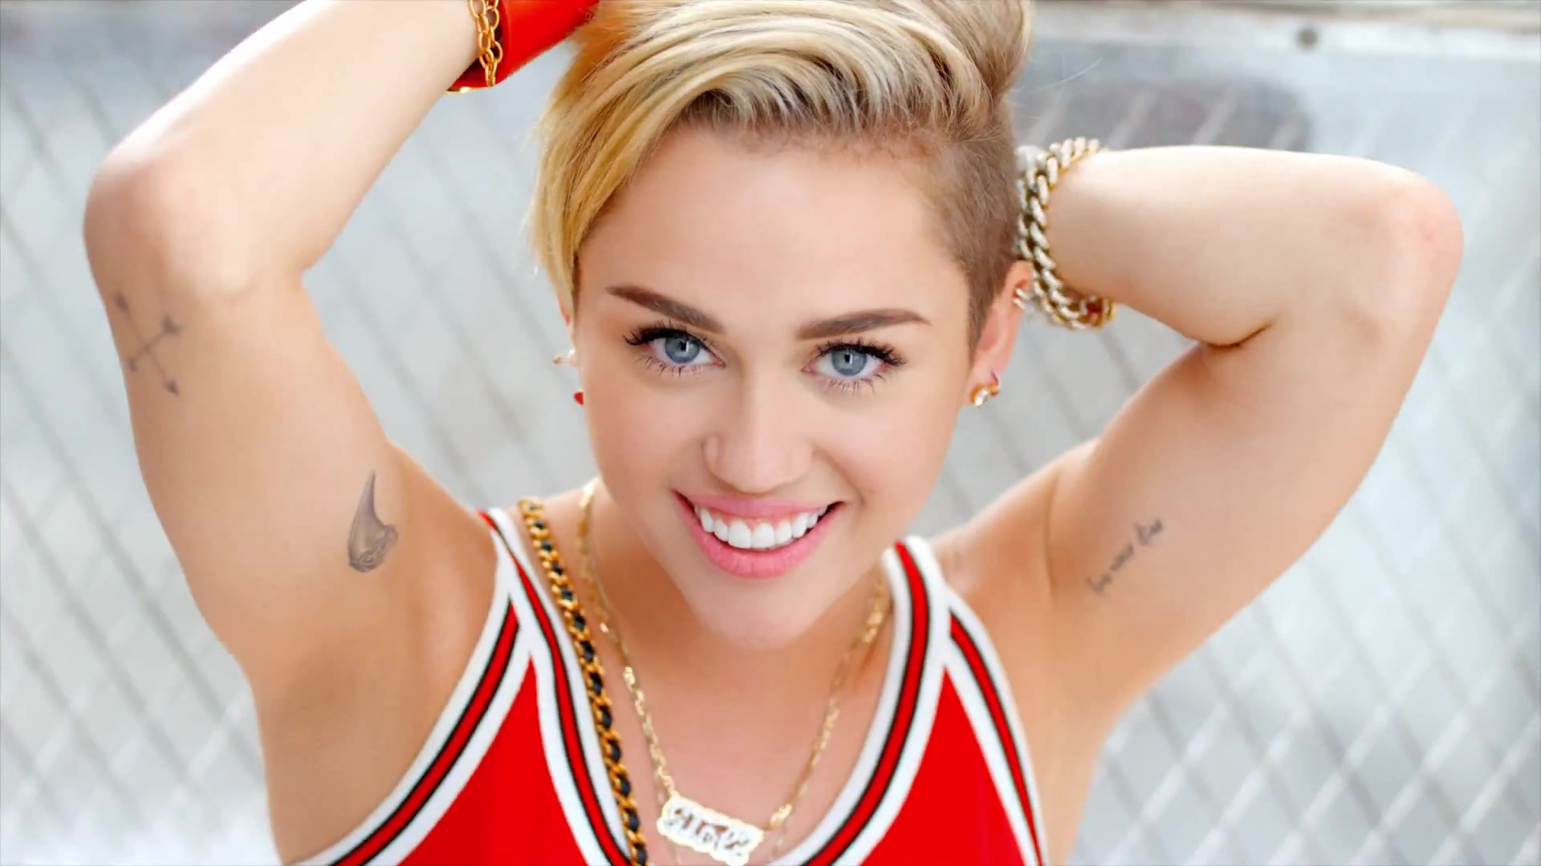
Miley Cirus
Remove

Slide 4
Selena Gomez
Remove

Slide 5
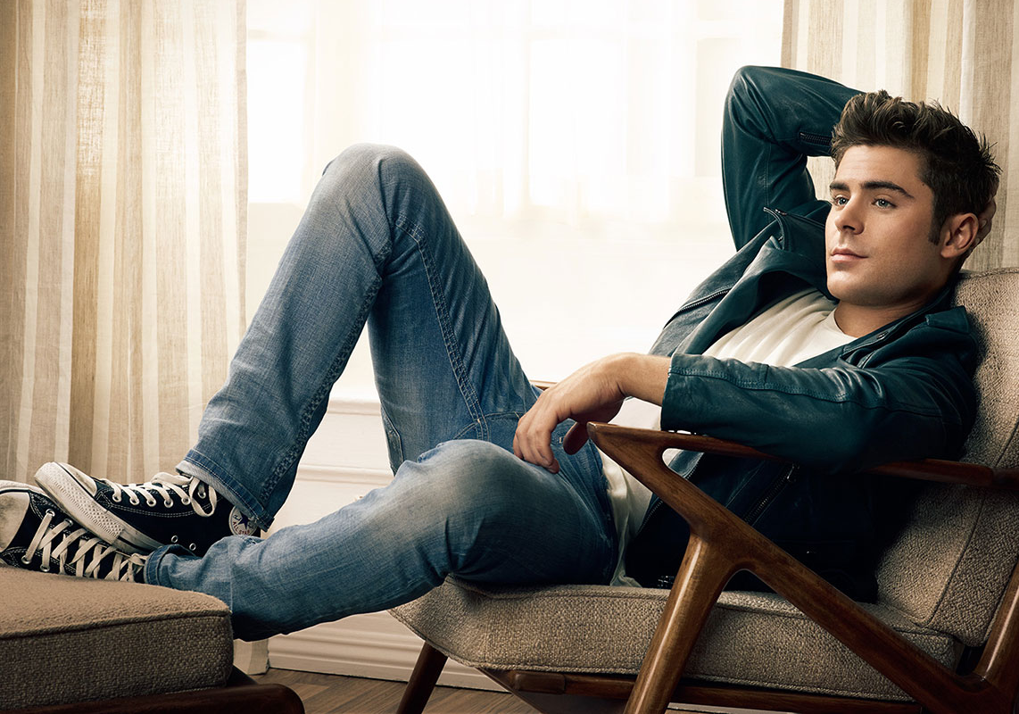
Zac Efron
Remove

Slide 6
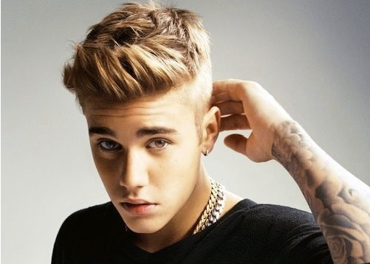
Justin Bieber
Remove

Slide 7
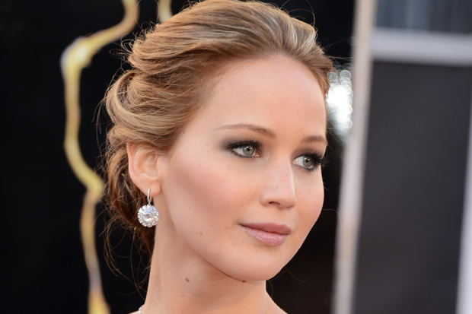
Jennifer
Lawrence
Remove

Slide 8
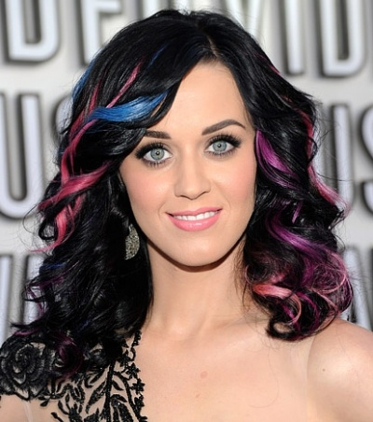
Katy Perry
Remove

Slide 9
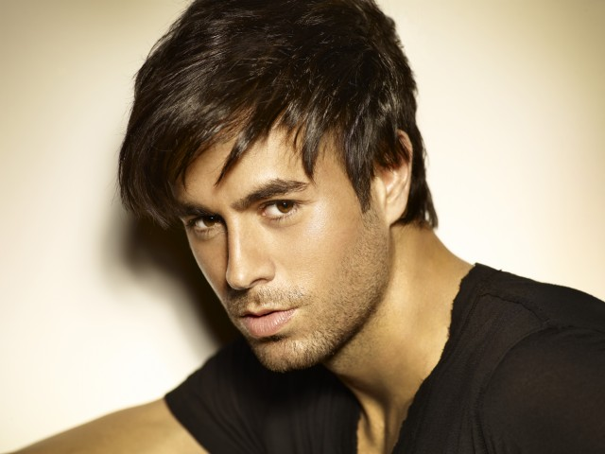
Enrique Iglesias
Remove

Slide 10
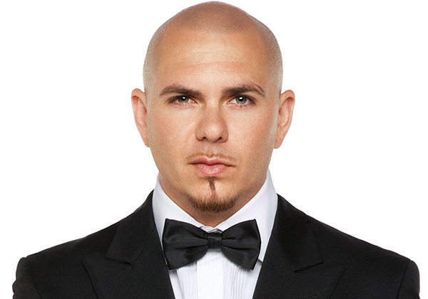
Pitbull
Remove

Slide 11
Angelina Jolie
Remove

Slide 12
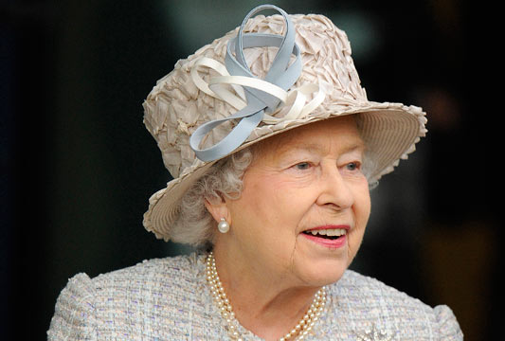
Queen
Elizabeth
Remove

Slide 13
Game Over

