Slide 2
pirate
treasure,
hook,
parrot,
skull,
island

Slide 3
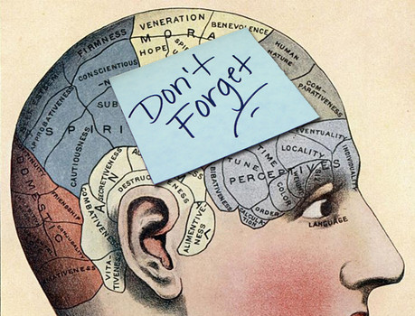
memory
Remember
forget
brain
computer

Slide 4
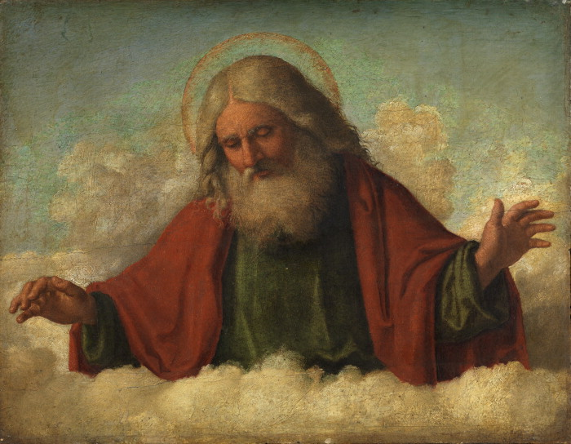
God
Creator
universe
Religion
Bible
Allah

Slide 5
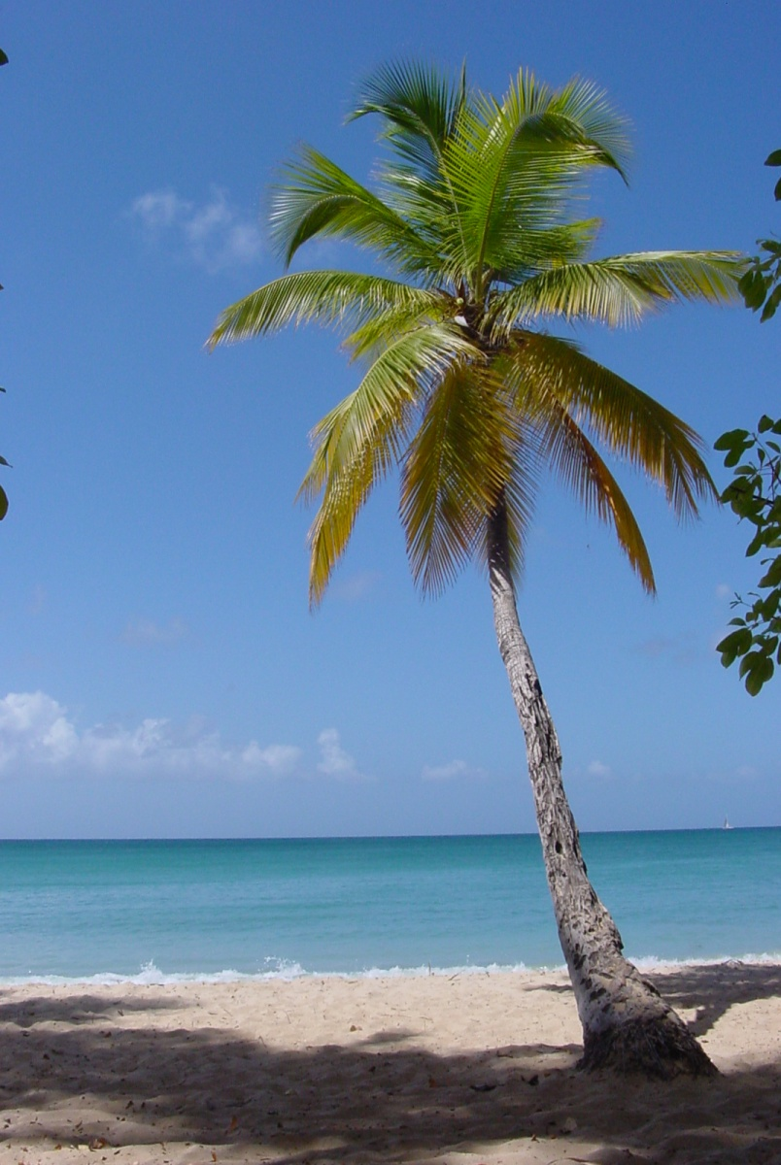
palm tree
Tropics
beach
coconut
tree
Palm/hand

Slide 6
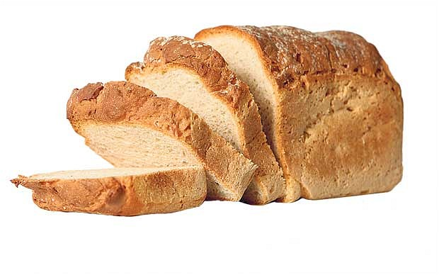
bread
Sandwich
bakery
flour
cheese
tea
butter

Slide 7
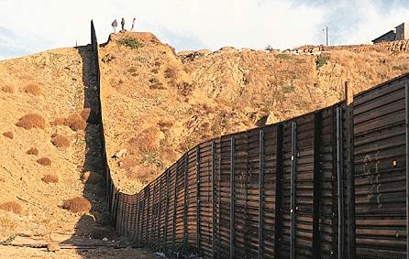
border
country
limit
customs
separation
neighbor

Slide 8
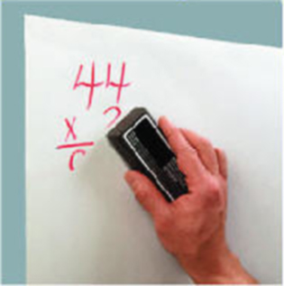
erase
eraser
lose
memory
delete
file

Slide 9
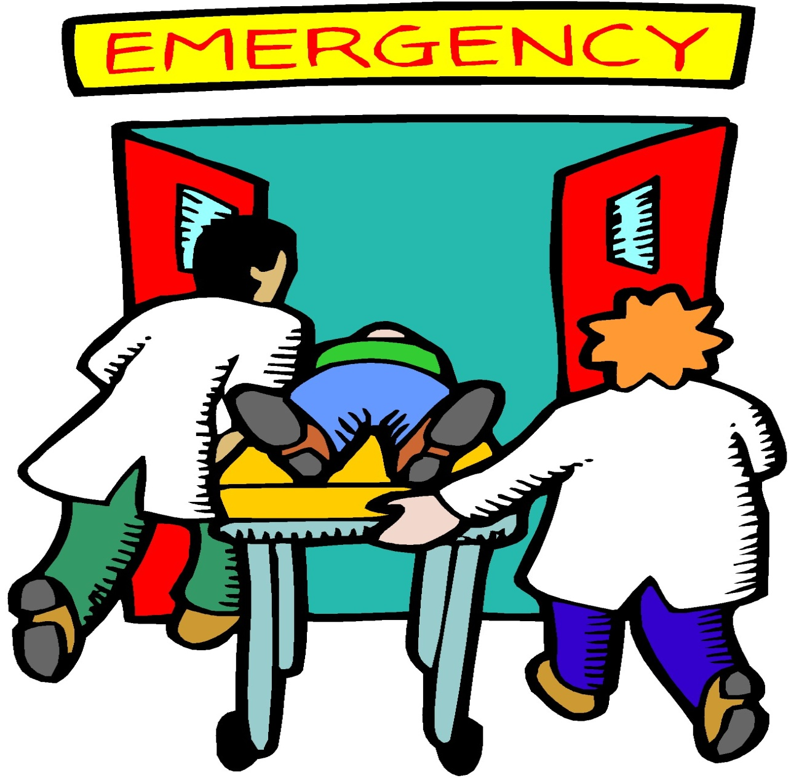
emergency
hospital
accident
blood
doctor
Heart attack

Slide 10
thank-you
polite
present
you're welcome
service

