Slide 1
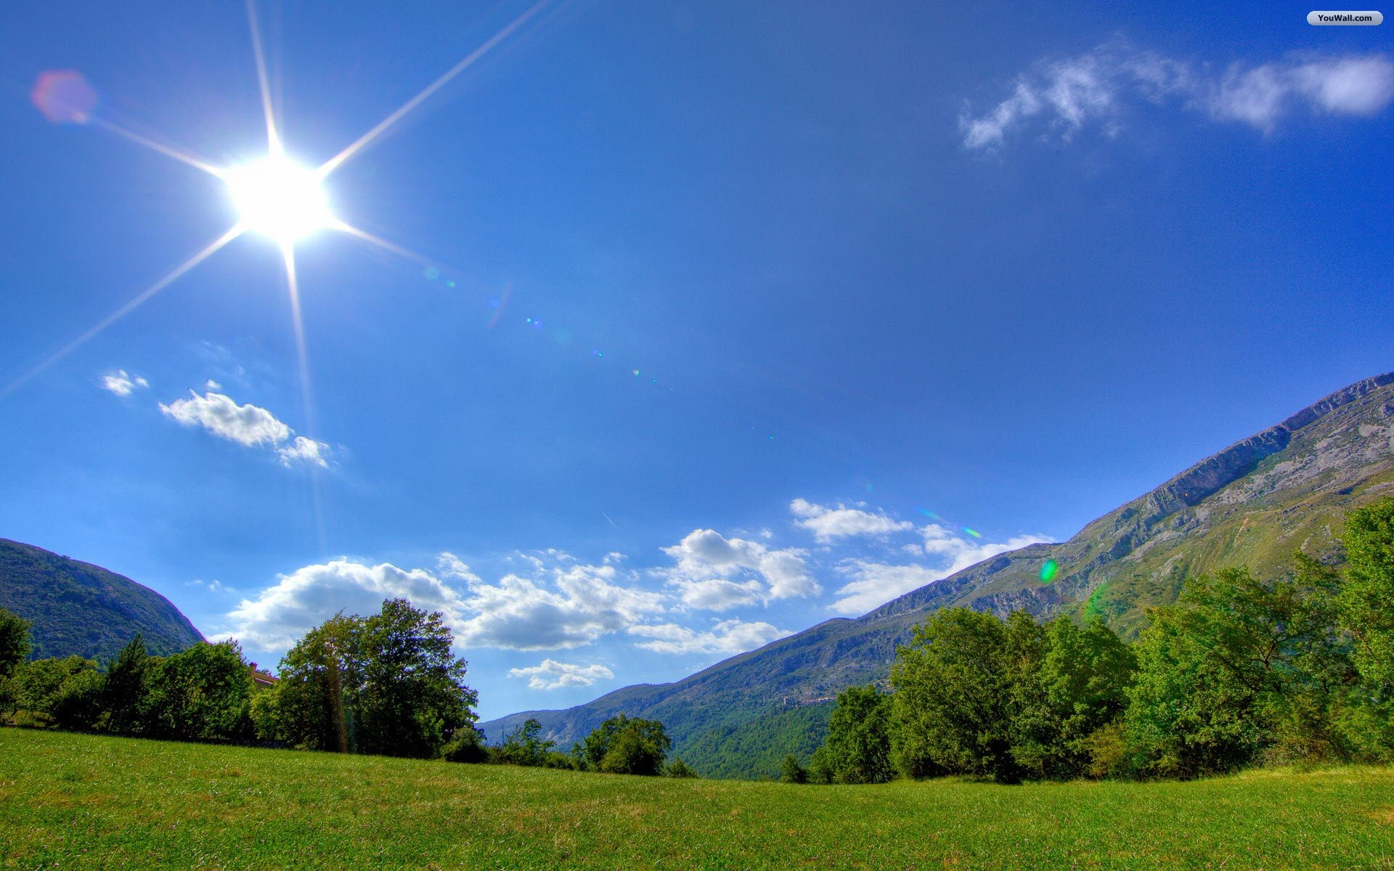
SUNNY bright/morning/summer/day/yellow

Slide 2
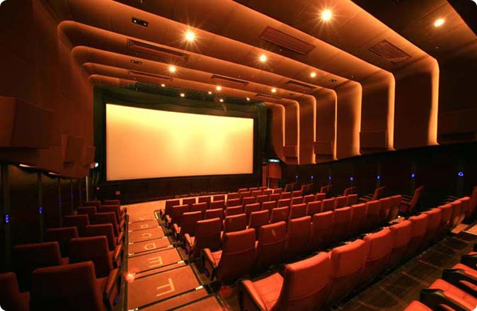
CINEMA film/movie/screen/seat/row

Slide 3
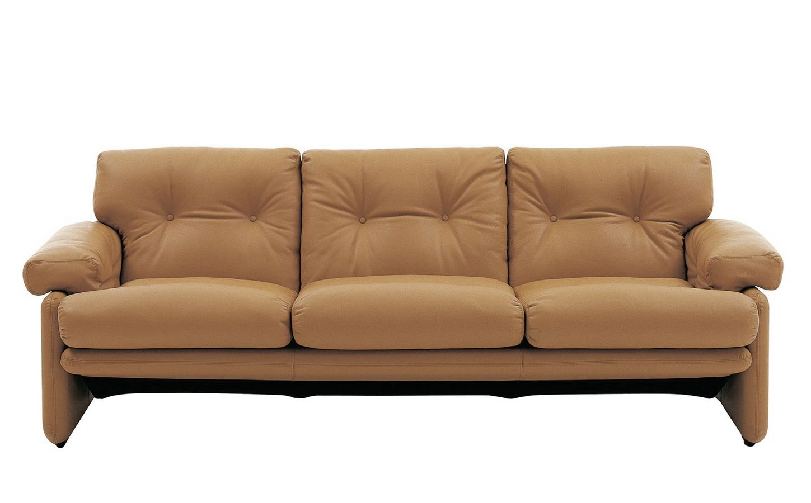
SOFA sit/living room/tv/furniture/relax

Slide 4
VIRUS email/flue/internet/dangerous/sick

Slide 5
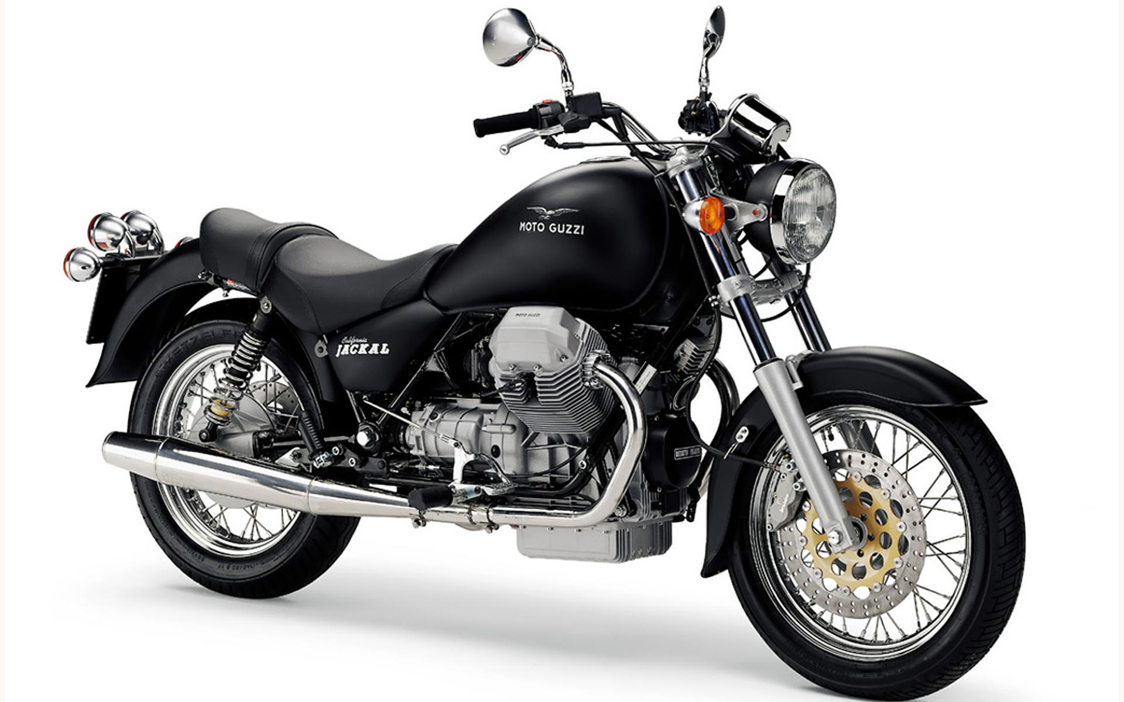
MOTORCYCLE helmet/drive/yamaha/honda/harley

Slide 6
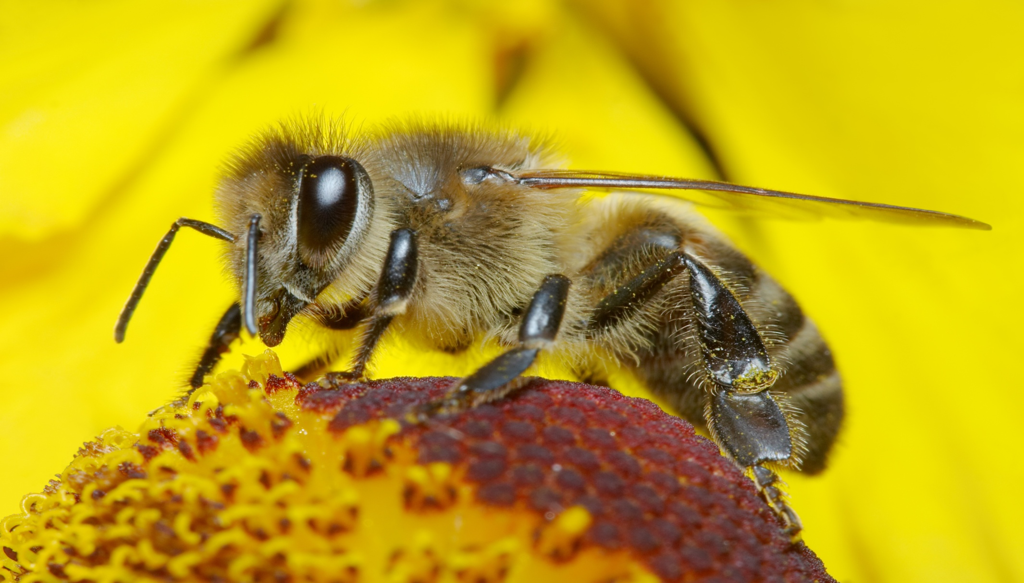
BEE honey/insect/hive/sting/maya

Slide 7
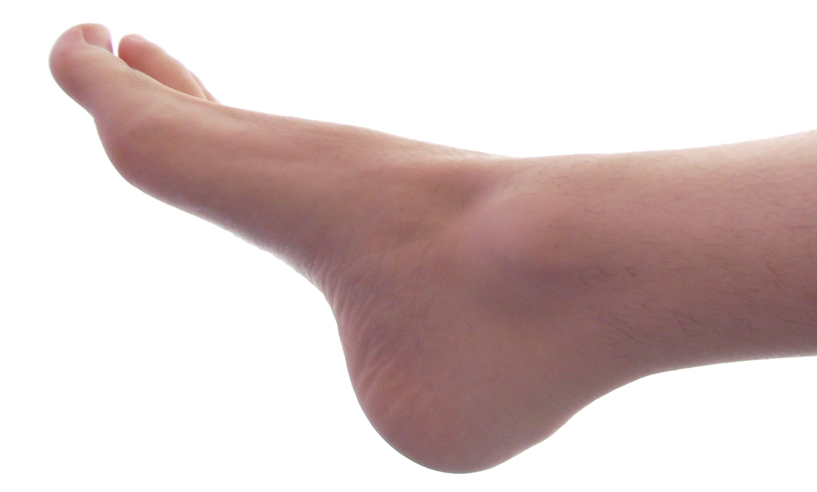
FOOT shoe/sock/toes/smell/body

Slide 8
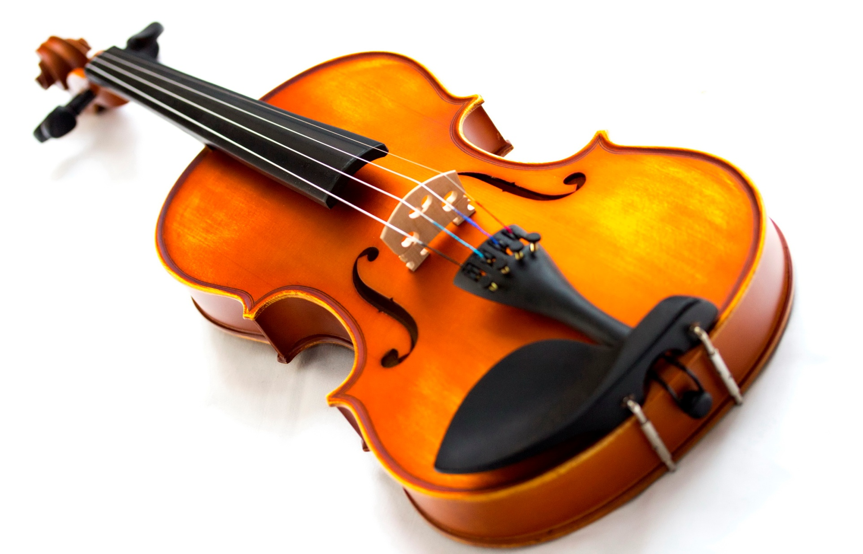
VIOLIN strings/orchestra/music/instrument/wood

Slide 9
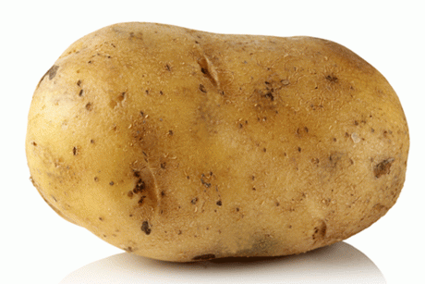
POTATO vegetable/french fries/eat/mash/chips

Slide 10
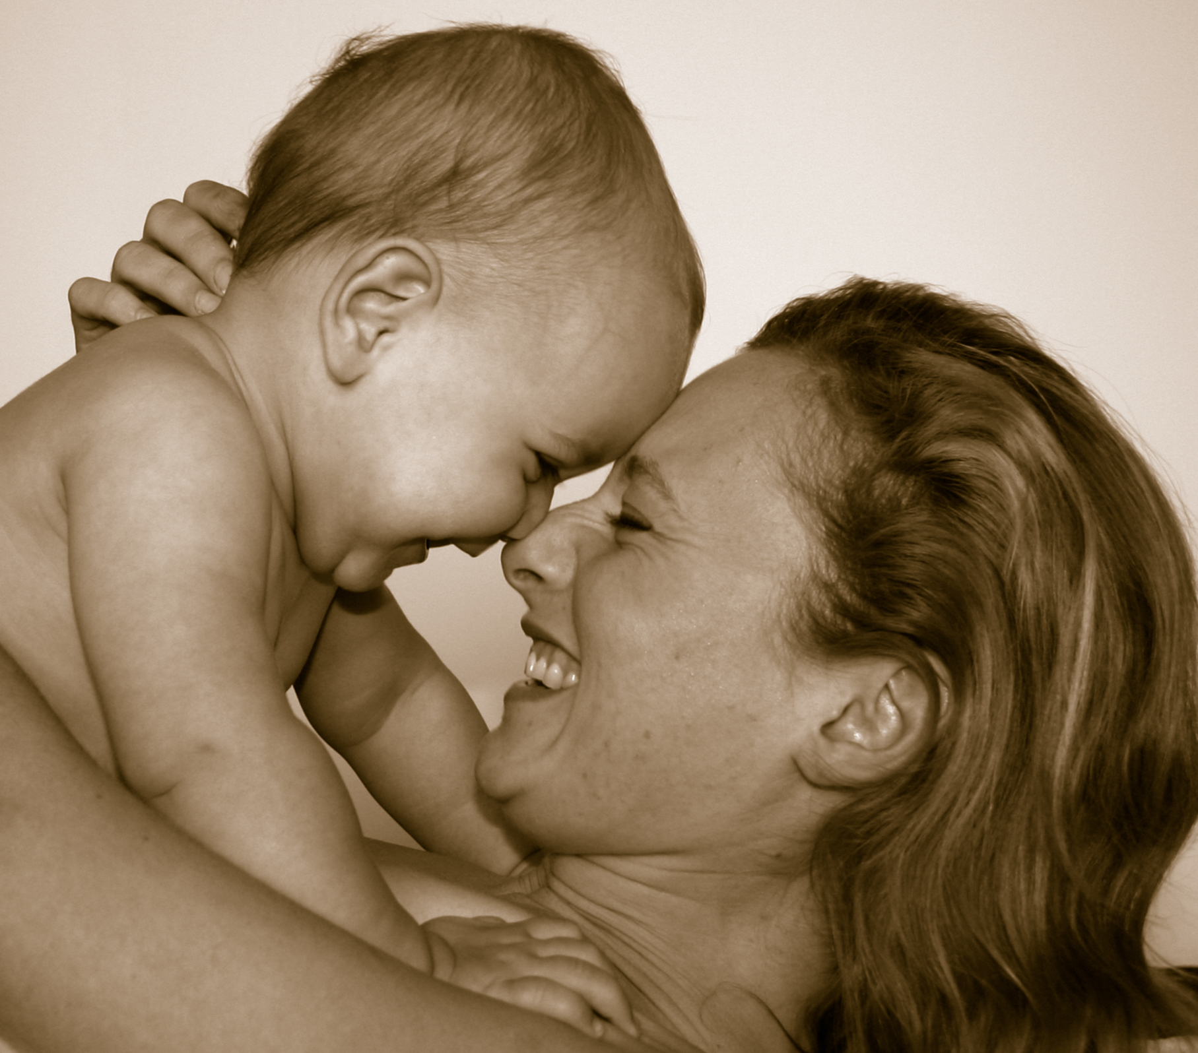
MOTHER woman/house wife/parent/children/father

Slide 11
HOLIDAY sun/beach/free/summer/school

Slide 12
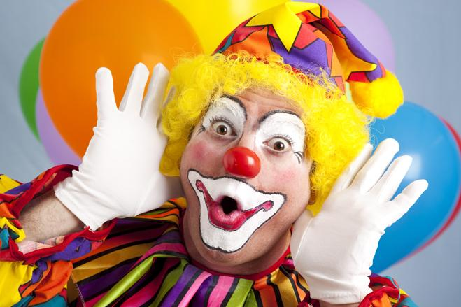
CLOWN joker/circus/red nose/make up

Slide 13
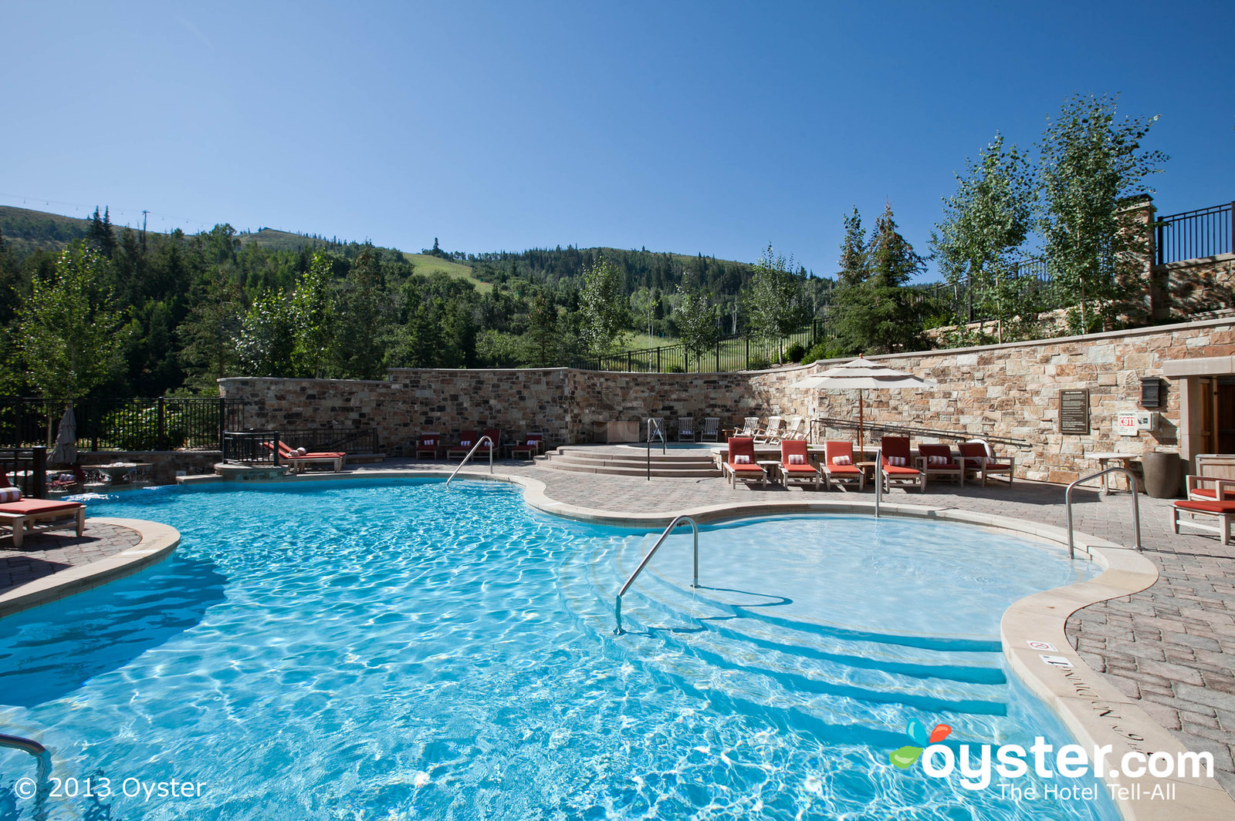
SWIMMING-POOL water/summer/slide/bath

Slide 14
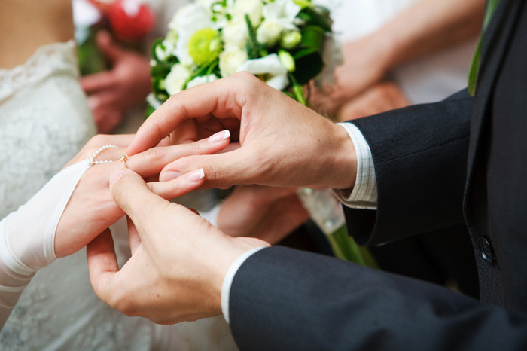
MARRY wedding/ring/groom/bride/cake

Slide 15
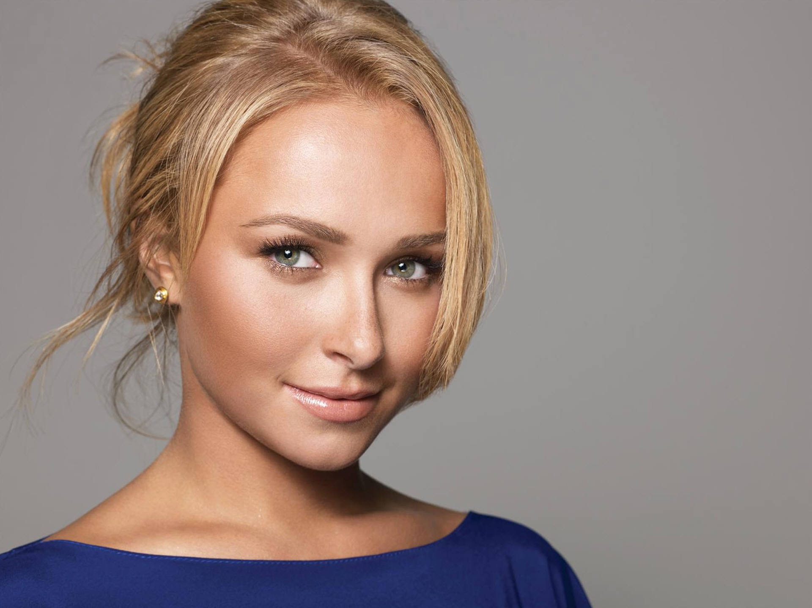
PRETTY Julia Roberts/beautiful/girl/attractive/Richard Gere

Slide 16
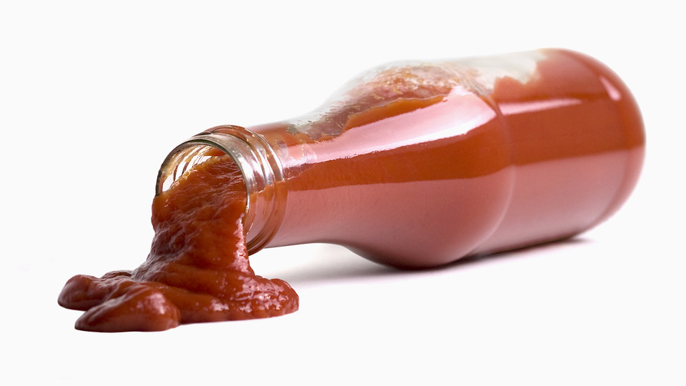
KETCHUP tomato/sauce/red/bottle

Slide 17
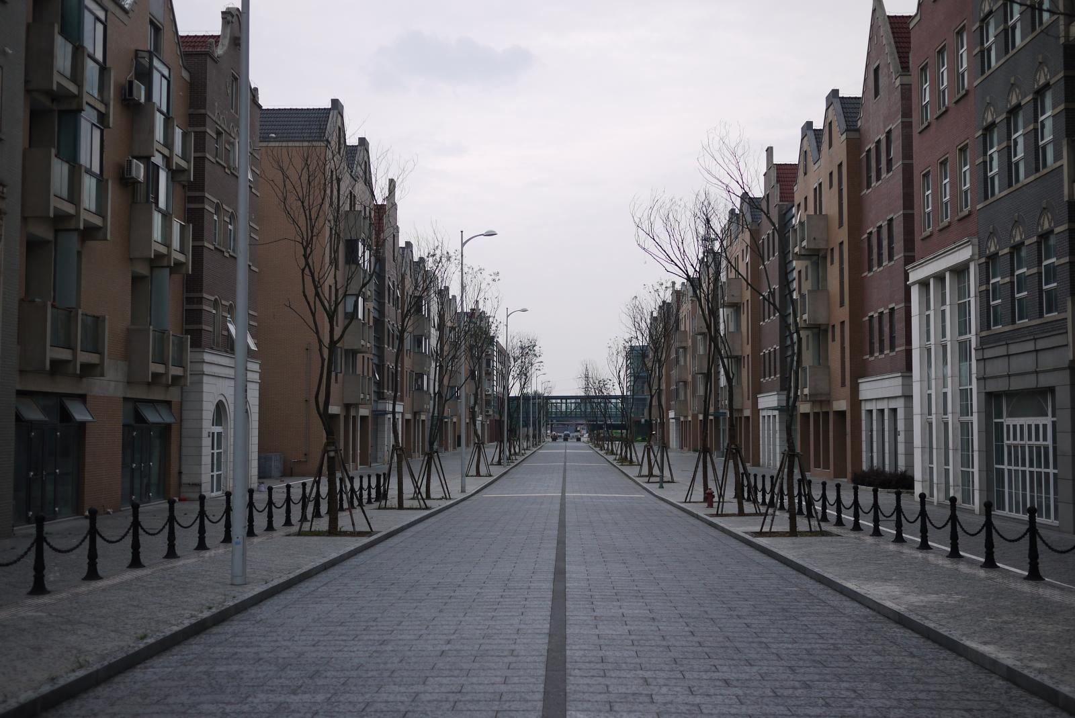
STREET road/pavement/drive/traffic/highway

Slide 18
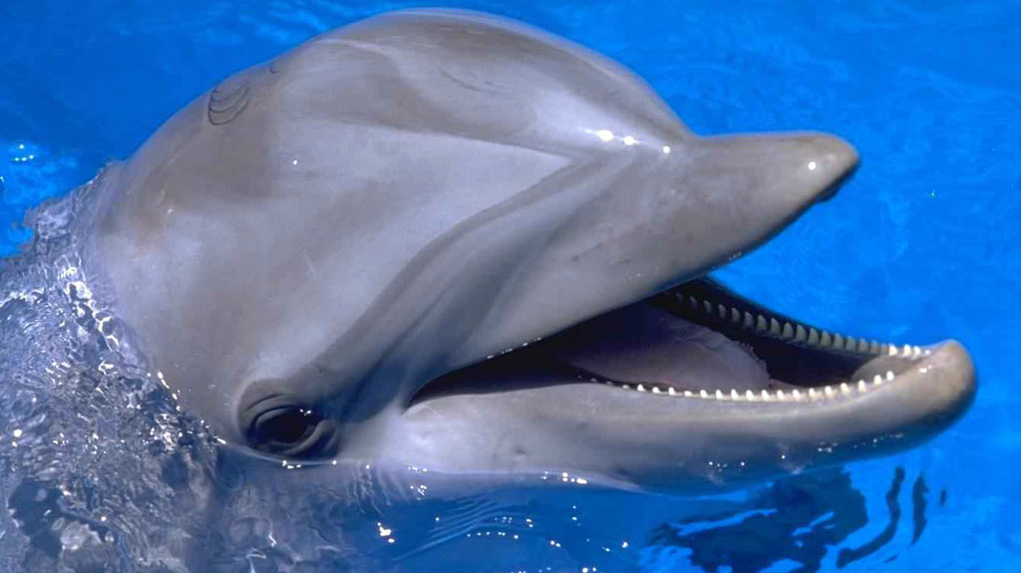
DOLPHIN ocean/swim/animal/fish/friendly

Slide 19
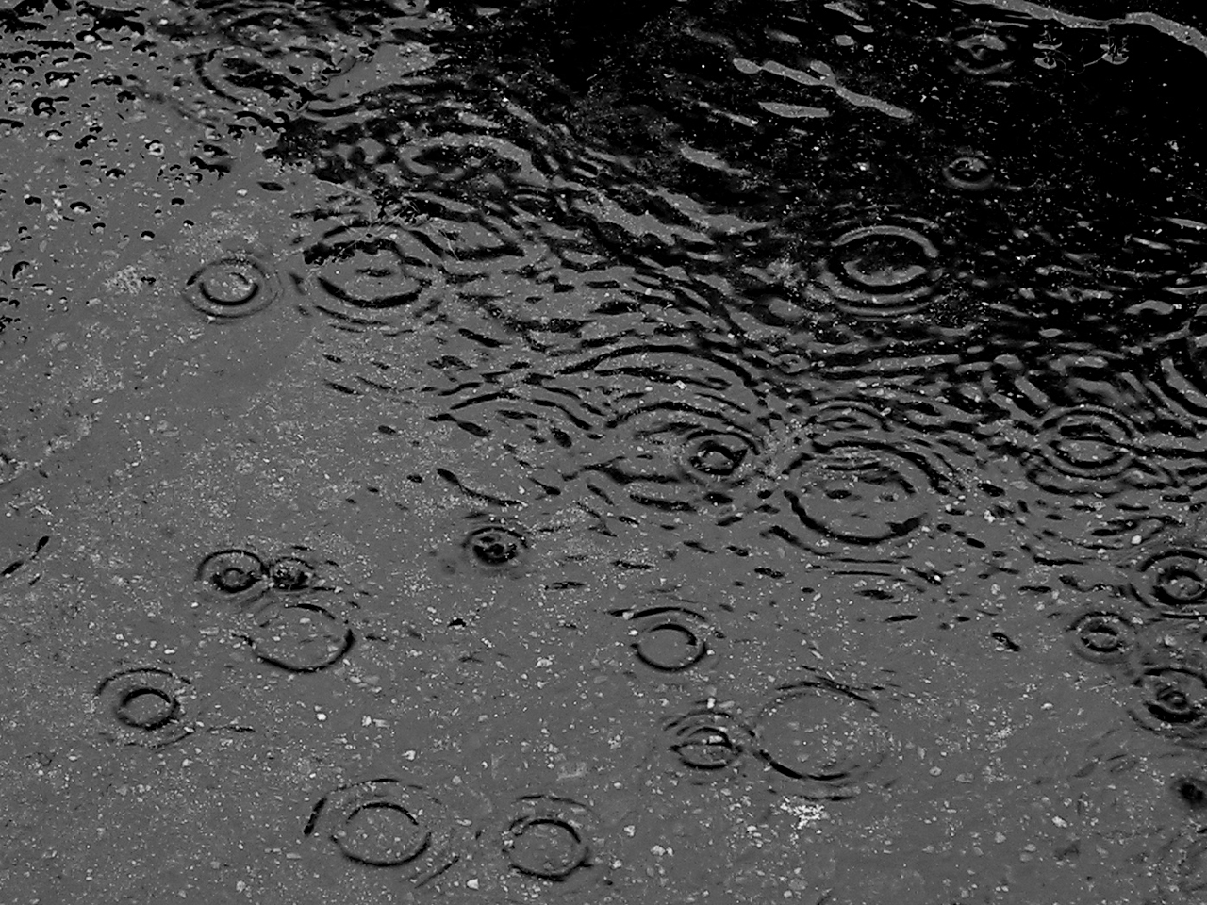
RAIN precipitation/water/sky/wet/drops

Slide 20
BOOK page/chapter/read/novel/library

Slide 21
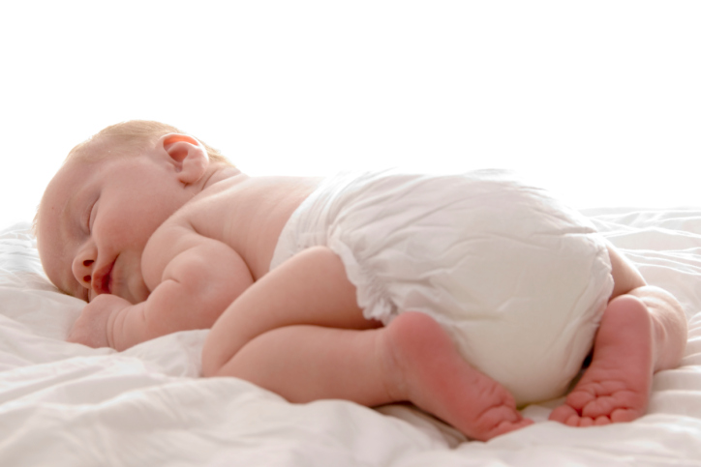
DIAPERS cloth/wet/baby/change/poop

Slide 22
LIPSTICK red/lips/women/beautiful

Slide 23
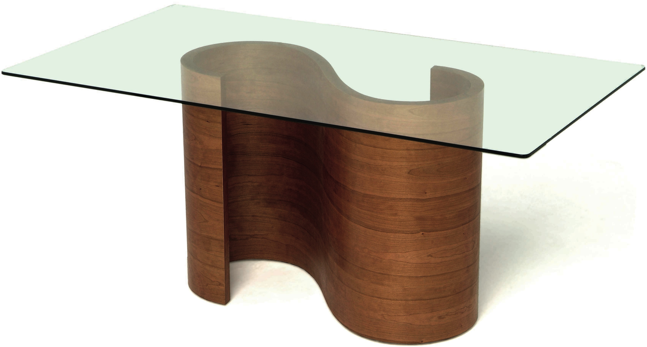
TABLE room/dish/furniture/wood/chair

