Slide 1
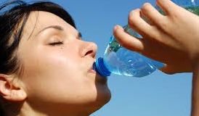
TABOO
WATER
Blue
See
Ocean

Slide 2
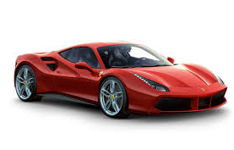
CAR
Uber
Taxi
All car brand names
(Ferrarri, Lamborgini, Tsuru, Toyota, Audi etc)

Slide 3
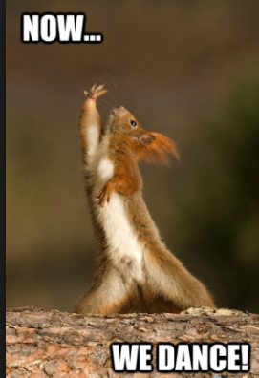
DANCE
Music
Shoes
Romantic

Slide 4
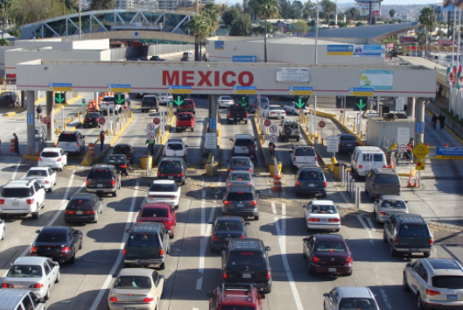
BORDER
Tijuana
United States
Line

Slide 5
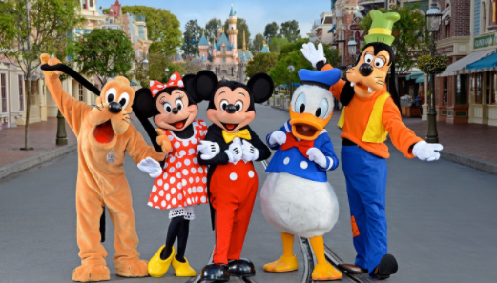
DISNEYLAND
Disney
Mickey Mouse
Pixar

Slide 6
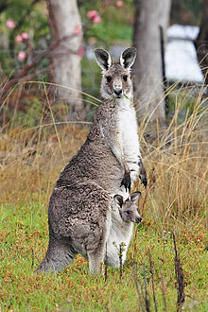
Kangaroo
Jumping
Cute
Hairy

Slide 7
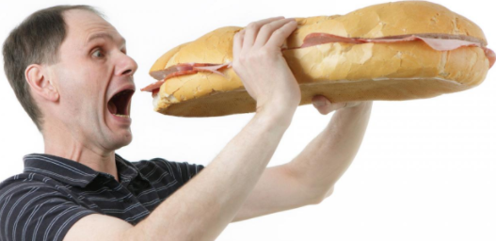
HUNGRY
Breakfast
Meal
Food

Slide 8
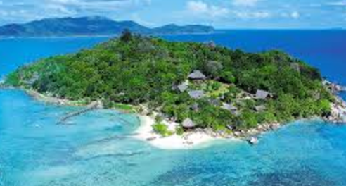
Island
Land
Small
Ocean

Slide 9
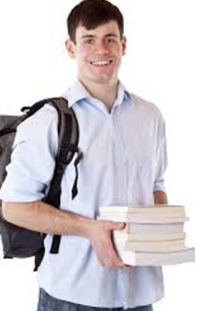
Student
Us
We
School

Slide 10
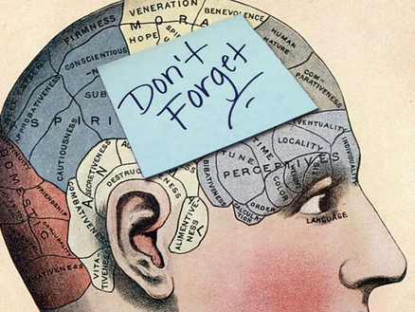
Memory
Remember
Think

Slide 11
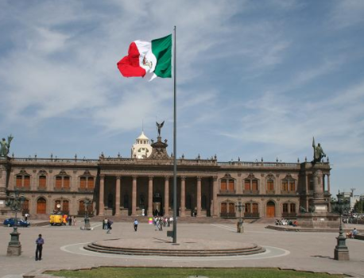
Government
Peña Nieto

